Slide 1
Min/Max values–the (lost) secret to DQ success
Data Quality Academy online

Slide 2
Min/Max ranges (1) - revision
Good quality routine health data is generally stable and consistent, and any large variations can and should be explained.
The setting of minimum and maximum ranges is to provide a guide as to what the data should not exceed and if used correctly assists in preventing/limiting extreme outliers
Therefore ranges should be wide enough to accept most values and narrow enough to trap values that are not likely.
Min/Max ranges are NOT punishment
In most cases with extreme outliers, there are no min/max values pre-set. Or if set- they are ignored

Slide 3
Min/Max ranges (2) - considerations
Used during data entry
Some data elements may show a fair degree of fluctuation that could be considered normal, condoms and other family planning supplies are a good example without the data being considered problematic
Can be used to catch disease/medical condition that is increasing
Be careful when using this for expected seasonal increased
Need access/rights to Data Entry screen – usually only granted to people who enter data based on User Role policy

Slide 4
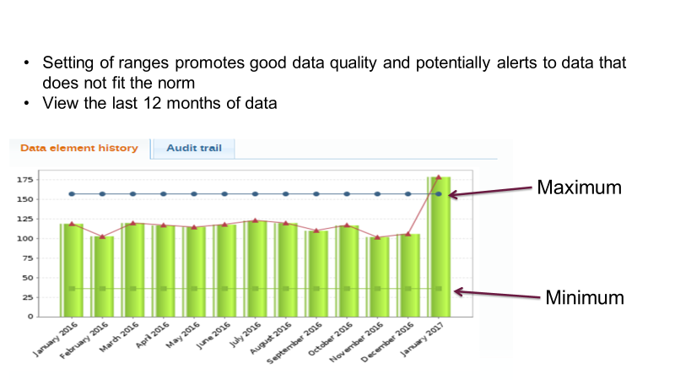
Min/Max values (3) – Data Entry – double click a value

Slide 5
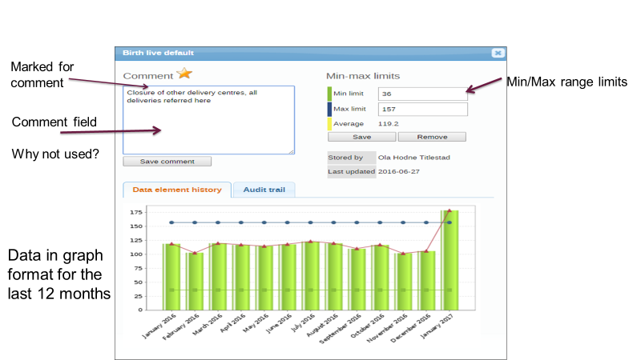
Min/Max (4) Review of Data Information Window – double click a value

Slide 6
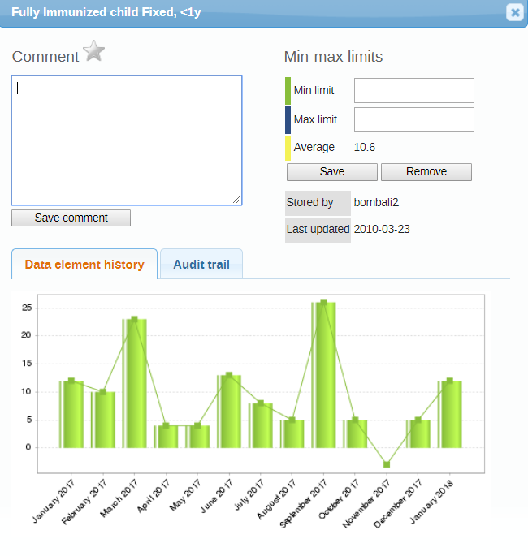
Min/Max (5) – thinking about ranges
No ranges set
Lots of variation
Eyeball the values – what range for this specific Data Element – can be suggest?
Min = 4
Max = 18
The range set here is only for this data element for this facility

Slide 7
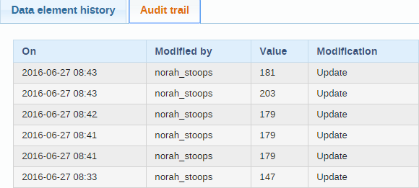
Min/Max (6) - Audit trail

Slide 8
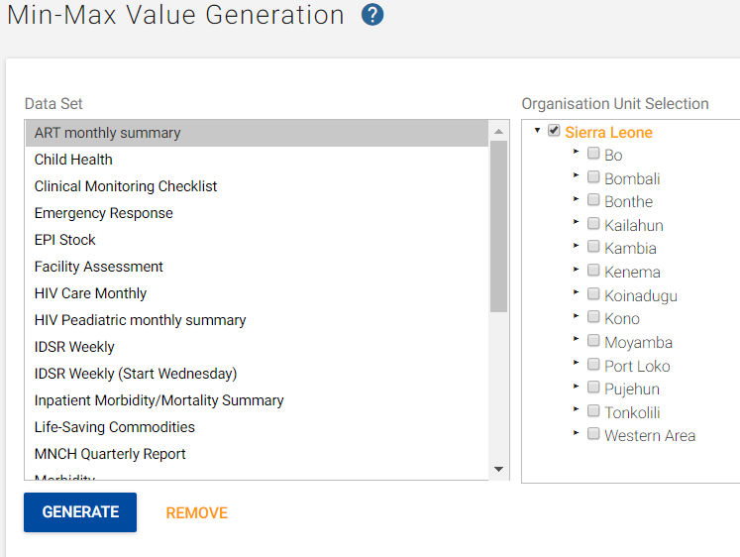
Min/Max (7) – Automatic range setting
How to set ranges automatically in bulk
Data Administration
Min/Max generation
Select Data Set
Select OU level – restrict selection
(select more than that and the system will crash)
Generate

Slide 9
Exercise
Access to own country DHIS2 OR DEMO database for this training
Confirm if Min/Max ranges have been set for your country – Country DHIS2 instance
On a Staging/testing instance
Generate Min/Max values for 1 dataset and limited OU level
If possible – open Data Entry screen and view Data Information Window
Run Min/Max violations for selected Data Set and OU level
Write a short report on violations
What is the action plan for this
On Demo database – follow the same instructions

